Slide 1
Phishing Awareness Training
Understanding, Identifying, and Preventing Phishing Attacks
CodeAlpha Internship - Task 2
Submitted By: Ayesha Noor

Slide 2
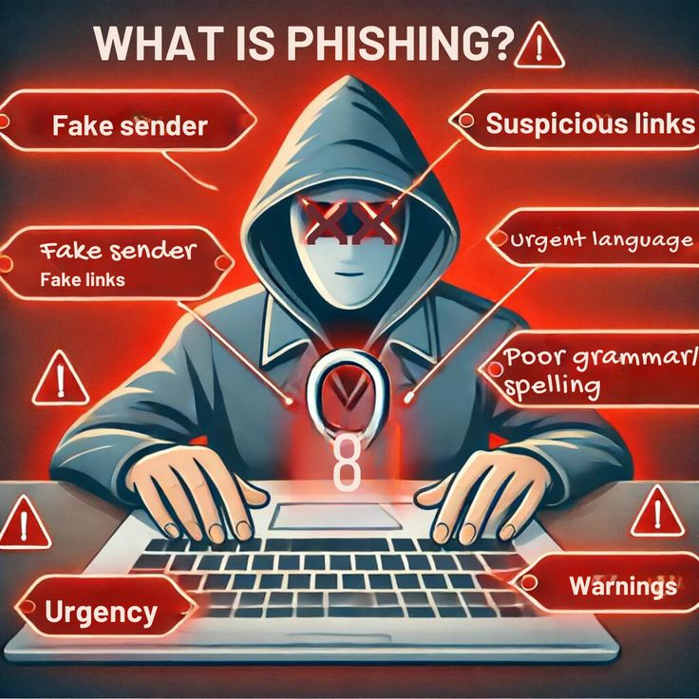
1 - Introduction
Phishing is a type of cyberattack where attackers impersonate legitimate institutions to trick individuals into sharing sensitive information such as passwords, credit card numbers, or login credentials. These attacks are often carried out through deceptive emails, fake websites, or fraudulent messages.
According to the Verizon Data Breach Investigations Report 2024, over 36% of data breaches involved phishing. Due to its simplicity and effectiveness, phishing remains one of the top cybersecurity threats today.

Slide 3
2 - Types of Phishing
📨
Email Phishing:
➤ Generic emails sent to many people
➤ Pretend to be from trusted sources (e.g., banks, companies)
➤ Aim: Steal passwords, credit card info, etc.
📞
Vishing (Voice Phishing)
➤ Fraudulent phone calls
➤ Impersonate tech support, government officials, or banks
➤ Aim: Extract sensitive info like OTPs or login details
🐋
Whaling
➤ Targets high-profile executives (CEO, CFO, etc.)
➤ Often involves fake business emails, legal threats, or financial requests
➤ Aim: Major data or financial theft
📱
Smishing (SMS Phishing)
➤ Phishing via SMS messages
➤ Pretend to be banks, courier services, etc.
➤ Contain links to fake websites

Slide 4
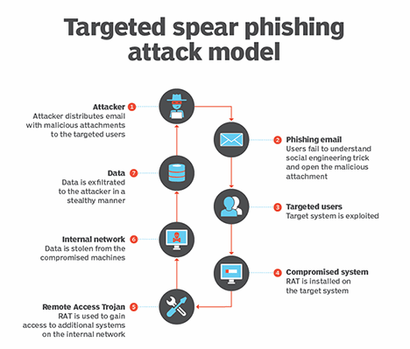
🎯 Spear Phishing
➤ Targeted at specific individuals or organizations
➤ Includes personal details to build trust
➤ Aim: Trick you into clicking malicious links or attachments

Slide 5
3 - How to Recognise Phishing Attempts
Phishing messages often seem legitimate but include clues that expose their malicious intent. Key signs include:
Urgent or threatening language "Your account will be closed!", "Immediate action required"
Spelling or grammar mistakes Professional companies rarely make these errors
Suspicious links Hover over the link before clicking to preview the URL
Unexpected attachments May contain malware or viruses
Fake email addresses Slightly altered to mimic real ones (e.g., paypall.com instead of paypal.com)
⚠️ Example: You receive an email saying your bank account has been locked and are asked to click a link to verify your identity. The link leads to a fake site.

Slide 6
4 - Social Engineering Tactics
Phishing often involves social engineering, where attackers manipulate people into giving away confidential information by exploiting emotions or trust. Common tactics include:
Impersonation of authority : Pretending to be a manager, IT admin, or CEO
Sense of urgency:
Forcing quick actions to bypass logic
Curiosity traps : "You've won a prize!" or "See who searched your name!”
These psychological tricks often bypass even strong security systems because the human element is the weakest link.

Slide 7
5 - 🛡️Best Practices To Avoid Phishing
🔗 Don’t click on links or download attachments from unknown or suspicious sources
📧 Verify the sender’s email address look for misspellings or unusual domains
🔐 Use Multi-Factor Authentication (MFA) wherever possible
🌐 Check URLs carefully before entering credentials secure sites begin with https://
🧠 Stay informed about the latest phishing trends and attack methods
🛑 Avoid responding to urgent or threatening emails demanding immediate action
🛡️ Install and update antivirus and firewall software
📚 Educate yourself and others awareness is the first line of defense

Slide 8

6 - Real World Example
Twitter Spear Phishing Attack (2020)
In July 2020, Twitter experienced a major security breach caused by a spear phishing attack targeting its employees.
🛠️ How it happened:
Attackers posed as Twitter IT staff and made phone calls to real Twitter employees.
They tricked employees into revealing credentials to internal tools by pretending to be part of support.
Using this access, attackers took control of high-profile accounts including:
Elon Musk, Barack Obama, Bill Gates, Apple, and Kanye West.
The accounts were used to promote a Bitcoin scam, asking people to send money with a promise of doubling it.
📉 Outcome:
Over $100,000 in Bitcoin was stolen.
The attack exposed weaknesses in internal employee training and access control.
Twitter was forced to limit access and improve its security protocols.

Slide 9
Conclusion
Stay Safe from Phishing
🔁 Recap:
Phishing is a major cyber threat
Comes in various forms email, SMS, voice, targeted attacks
Recognizing signs is key to prevention
🕵️‍♀️ Take Action:
Report suspicious emails or messages immediately
Encourage a cyber-aware culture in your organization
⚠️ Final Reminder:
Stay alert
Stay informed
Stay safe

